Slide 1
Teaching and Learning
APA Style, 7th Edition
Part 3: Formatting

Slide 2
Objectives
Learn APA guidelines for document formatting:
Margins, spacing, and font
Headings
Tables and Figures
Bulleted and numbered lists
Numbers
Verb tense and pronouns
Additional resources and Q&A

Slide 3
APA Formatting: Overview
Double spacing throughout document (except tables and figures)
1 inch margins
Left alignment (except title page and some headings
Paragraphs are indented .5 inches
Title page is page 1
The same font should be used throughout the text of the paper. APA Style suggests a variety of fonts, both sans serif and serif (see p. 44). At the Writing Center, we recommend Times New Roman 12 pt.
Insert one space after punctuation marks at the end of a sentence; commas, colons, and semicolons; periods between parts of a reference entry; and periods following initials in names.

Slide 4
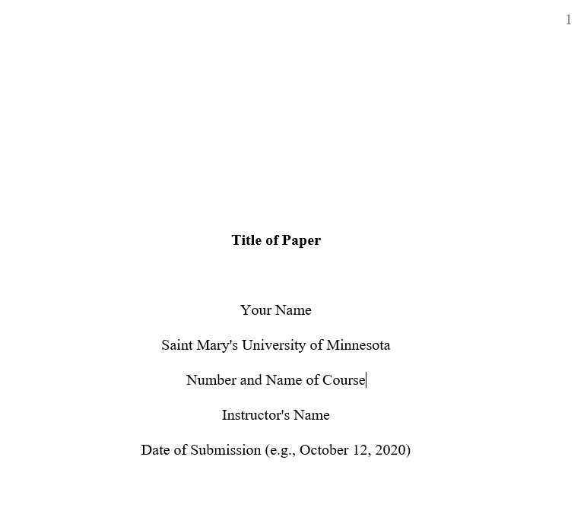
Sample Title Page
No running head
Title page is Page 1
Title of paper in bold font
Extra space between title and name
For another example, see p. 32 of the APA Manual

Slide 5
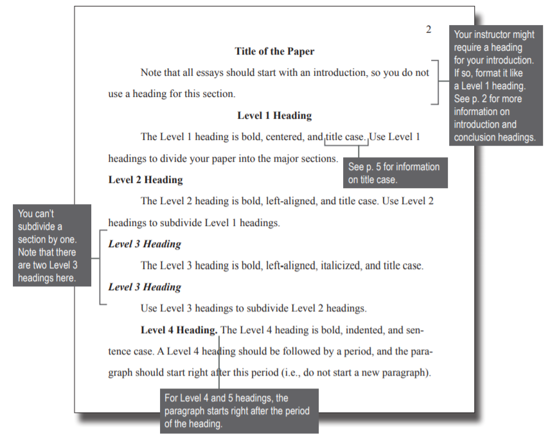

Slide 6
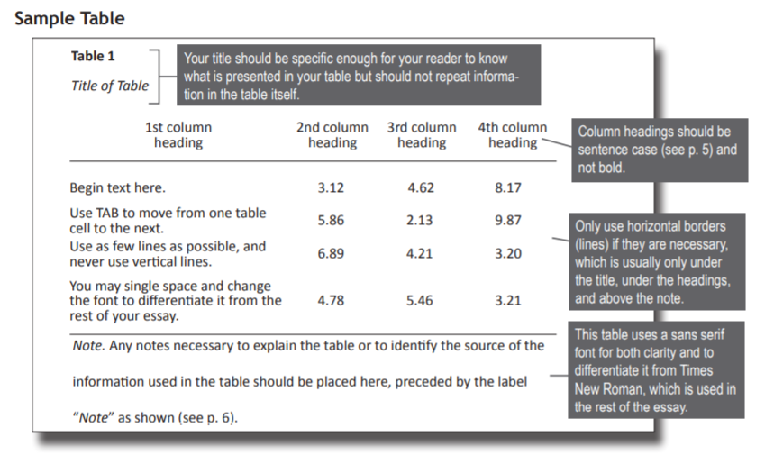
Tables

Slide 7
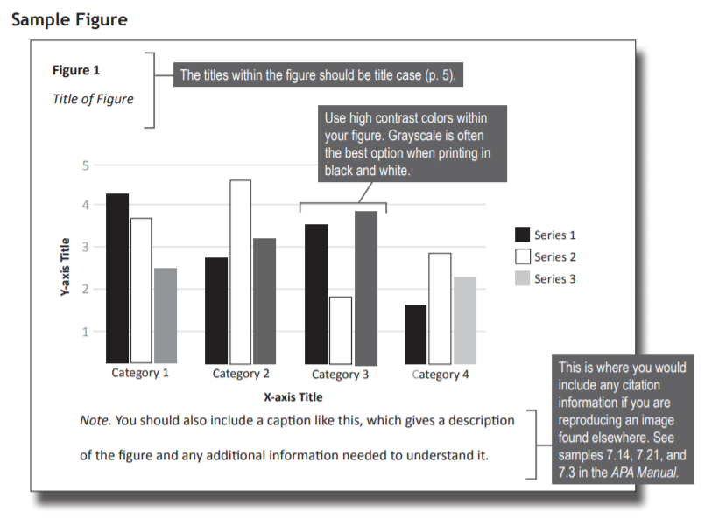
Figures

Slide 8
Lettered Lists
Use a lettered list when doing so will improve clarity, or will help draw attention to the items
Use commas or semicolons between the items
We tested three groups: (a) low scorers, who scored fewer than 20 points;
(b) moderate scorers, who scored between 20 and 50 points; and (c) high
scorers, who scored more than 50 points.
(APA, 2020, pp. 189-90)

Slide 9
Numbered Lists
Use a numbered list to “display complete sentences or paragraphs in a series (e.g., itemized conclusions, steps in a procedure)”
If the items are phrases, use a lettered or bulleted list.
We addressed the following research questions:
What research methodologies are used to examine the effects of cultural competency training?
How are psychologists trained to be culturally competent?
How are training outcomes assessed?
What are the outcomes of cultural competency training?
(APA, 2020, pp. 189-90)

Slide 10
Bulleted Lists
Use bullets to identify items in a series without implying chronology or order of importance.
Symbols includes small circles, squares, and dashes are acceptable.
For items that are complete sentences, begin each sentence with a capital letter
For items that are not full sentences, begin each item with a lowercase letter.
See pp. 190-191 for examples.

Slide 11
Bulleted Lists, Continued
There are several ways in which psychologists could apply social-media-driven methods to improve their work:
Social psychologists could use these methods to improve research on emotional experiences.
Community psychologists could use these methods to improve population assessment at the city level.
Clinical psychologists could use these methods to improve assessment or treatment.
(APA, 2020, p. 190)

Slide 12
Numbers
With some exceptions, numbers 10 and above are expressed as numerals and numbers below 10 are expressed as words.
Numerals are also used for the following:
“numbers that immediately precede a unit of measurement” (e.g., a 5-mg dose)
“numbers that represent statistical or mathematical function, fractional or decimal quantities, percentages, ratios, and percentiles and quartiles” (e.g.,3 times as many, more than 5%, the 5th percentile)
“numbers that represent time, dates, ages, scores and points on a scale, exact sums of money, and numerals as numerals” (e.g., 5 days, 1 hr 34 min, the numeral 6 on a keyboard)
“numbers that denote a specific place in a numbered series and parts of books or tables” (e.g., Grade 4, Chapter 1)
(APA, 2020, pp. 178-81)

Slide 13
Numbers, Continued
Use words to express the following:
numbers zero through nine
numbers that begin a sentence, title, or heading
common fractions (e.g., one fourth of the class)
universally accepted usage (e.g., Five Pillars of Islam)
To form the plurals of numbers, add “s” or “es” without an apostrophe
twos and sixes; the 1990s; 20s and 30s
(APA, 2020, pp. 178-81)

Slide 14
Verb Tense
Paper section | Recommended tense | Example
Literature review (or whenever discussing other researchers’ work) | Past Present perfect | Quinn (2020) presented Since then, many investigators have used
Method Description of procedure | Past Present perfect | Participants completed a survey Others have used similar approaches
Reporting of results | Past | Results were insignificant Scores increased Hypotheses were supported
Discussion of implications of results | Present | The results indicate
Presentation of conclusions, limitations, future directions, and so forth | Present | We conclude Limitations of the study are
Adapted from American Psychological Association (2020). Publication Manual of the American Psychological Association (7th ed.), p. 118.

Slide 15
Pronouns
Use “I” when writing a paper by yourself”; only use the pronoun “we” if you have coauthors.
Do not use “we” when referring to people in general.
Incorrect: We strive to encourage a love of reading.
Correct: Elementary school teachers strive to encourage a love of reading.
Use the singular “they” to refer to a person for whom “they” is the preferred pronoun, or in situations were gender is unknown or irrelevant to the context. The variant “themself” is acceptable.
Use “who” for human beings; use “that” or “which” for inanimate objects and nonhuman animals.

Slide 16
Additional Resources
Student Workshops
Faculty Webinar Series
Intro to APA Handbook
APA Templates
APA Website and Style Blog (apastyle.apa.org)
Contact write@smumn.edu!
Questions?

